Slide 1
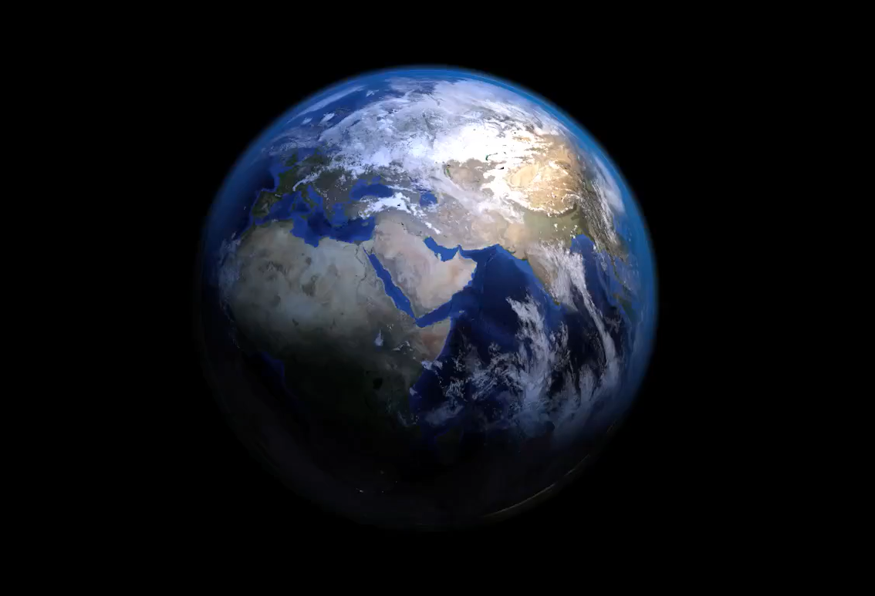
All images copyright-free from pixabay, unless otherwise identified
Notes:
Gathering:
Slide 1: Spinning earth stilling exercise
Use the stilling slide if desired: the suggested words should be spoken slowly, leaving pauses inbetween to create a sense of stillness.
As you sit quietly, watch the surface of the water rippling…… [PAUSE]
Now practise slower breathing…..in…..and out…..in……and out…..as you watch….[PAUSE]
You maybe notice that you are feeling calmer and more relaxed….[PAUSE]
As you breathe, think about yourself and what you bring into this time today….. [PAUSE]
We come into this special / sacred space and time to be still….to think deeply…..to be together as a school community…..
In our time together today, we will share some photos together, share a story, and then share our thinking.
But first, let’s welcome one another as we begin….

Slide 2

Leader: As we gather to share our story today….
All: May we grow in our understanding of ourselves and our wonderful world.
Notes:
Slide 2: Use our new gathering words for this term, or your usual greeting if you prefer. These greetings may change slightly each week to reflect the spiritual elements that we will be exploring in each week’s materials.
Leader: As we gather to share our story today….
All: May we grow in our understanding of ourselves and our wonder-ful world.

Slide 3

Stories that help us to grow
Notes:
Slide 3: You may remember that this term, we are exploring stories that help us to grow, and today’s story is brand new and written just for this series!

Slide 4
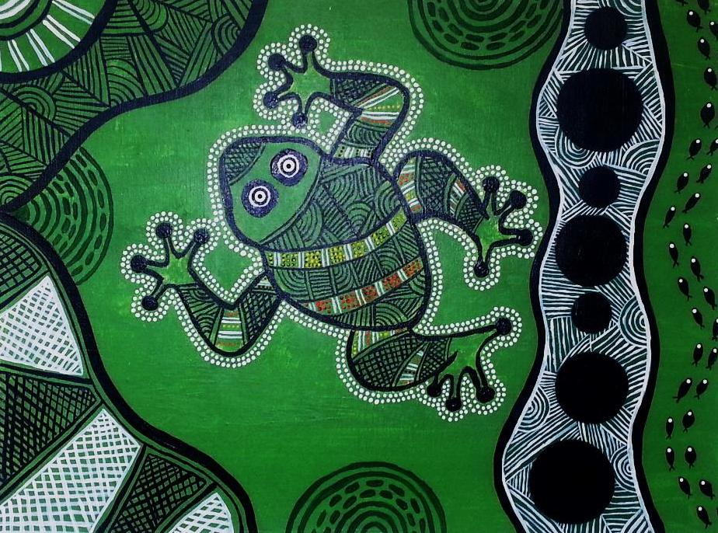
Our thanks to artist Sam Lyons for allowing us to use her work:
https://samlyonart.wordpress.com/2015/01/24/aboriginal-green-frog/
Tiddalik
Notes:
Slide 4: Last week, we heard about Tiddalik the giant bull-frog and how he greedily stole all the water in the billabong, and our theme for today links with this…..but first, we’re going to look back at a couple of ground-breaking events in very recent history.

Slide 5
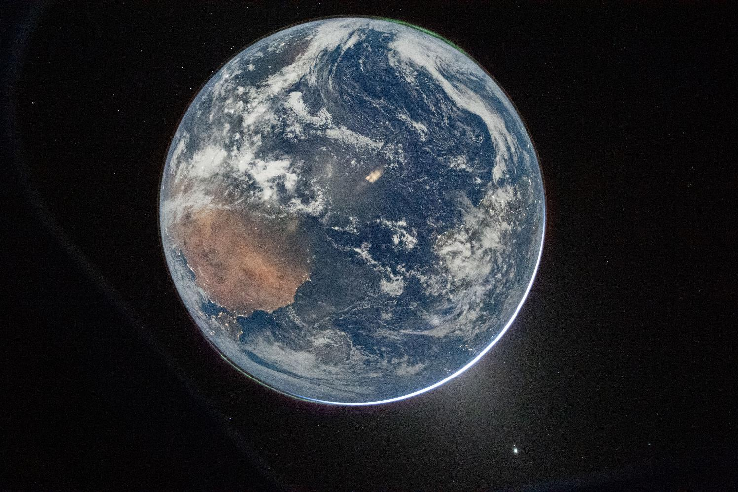
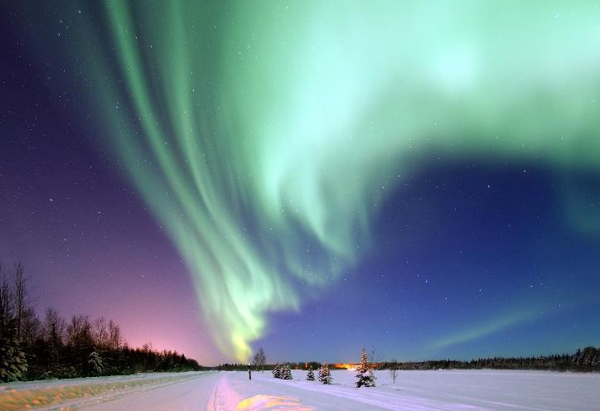
Aurora Borealis
Northern Lights
Aurora Australis
Southern Lights
Image ©NASA
Notes:
Slide 5: NASA image of Planet Earth
This is an image of our beautiful shared home, Planet Earth. It was taken by a tiny spacecraft that was sent to orbit (circle) the Moon and take photos of parts of the Moon that had never been seen before! You might remember the images we saw 3 weeks ago, which were taken from the same spacecraft in April this year.
The 9-day mission was called Artemis II (2) and took 4 astronauts further away from Earth that had ever been possible before. Although they were there to photograph the Moon, they were also able to capture some images of our beautiful planet…..You can see here on this image both sets of aurora – the Northern Lights and Southern Lights – nature’s light shows which are best seen in the very north or the very south.

Slide 6
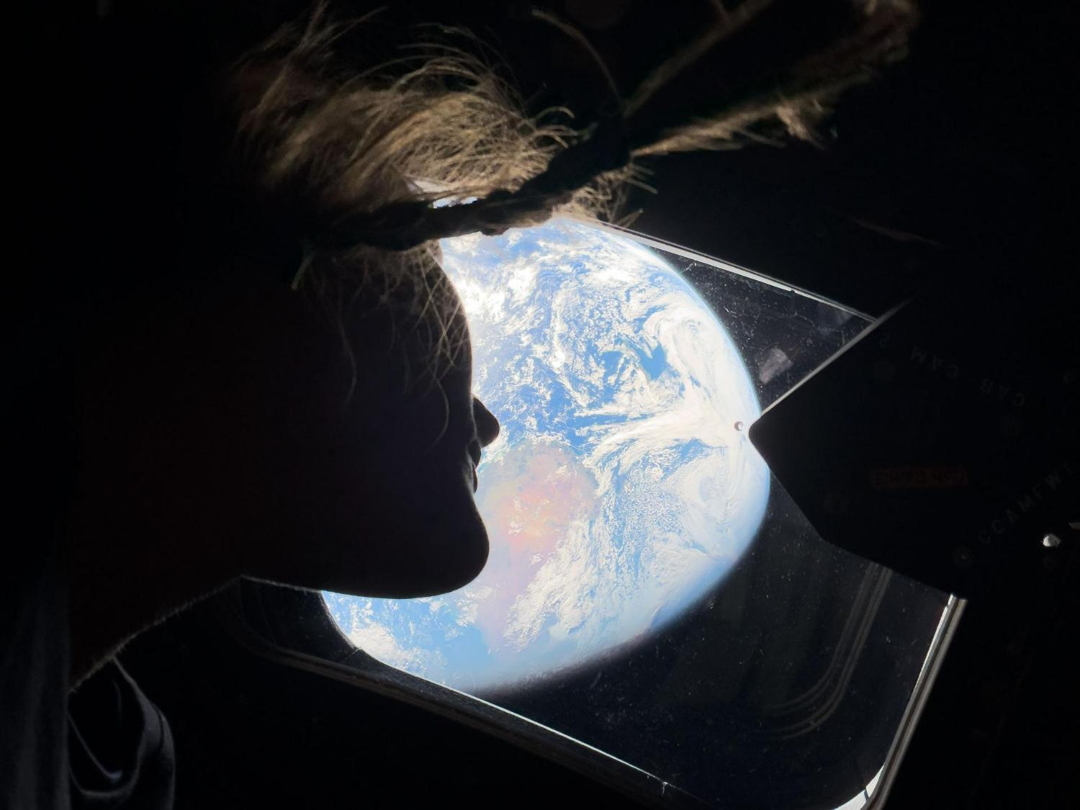
Image ©NASA
Notes:
Slide 6: View of Planet Earth from the Artemis II mission spacecraft
I wonder what this astronaut is thinking as she sees our Planet Earth from the window? [ask some children]

Slide 7
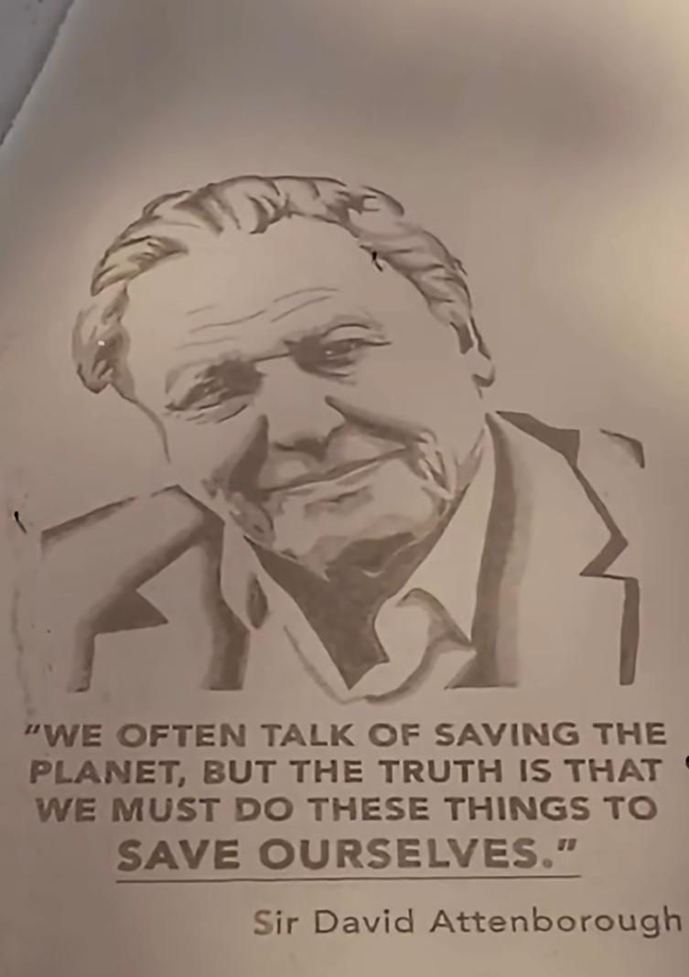
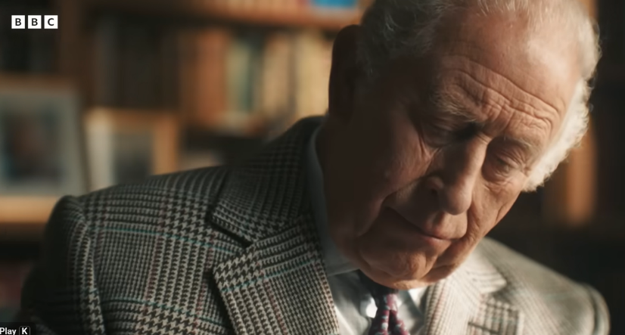
Notes:
Slide 7: Sir David Attenborough turns 100
This year also marked a very special birthday – the 100th birthday of Sir David Attenborough. I expect that some of you may have had your own celebrations in school…. [you might like to reference these]. King Charles sends special messages to anyone who turns 100, and he sent a very special message to Sir David [watch here if you have time, or later if you wish; it links from the image – and from the script for today.]
You will probably remember from any of the images you saw of his celebrations that our Blue Planet featured in so much of his work. He has helped so many of us to both appreciate its beauty and reflect on its fragility, and it’s these ideas that are going to feature in our story for today….Our story is called…..
NB This image of Sir David was created in sand on Morecambe Beach. You can watch the video of it being created, linked from the resources list.

Slide 8
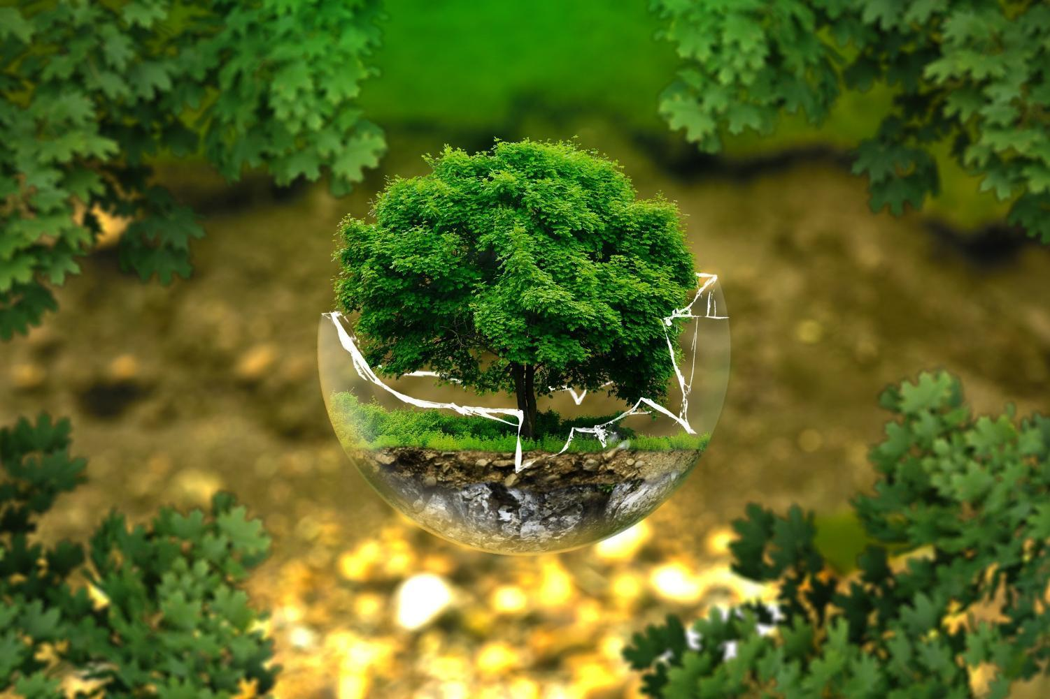
The fragile gift
Notes:
Slide 8: The Fragile Gift…a reflective, interactive story….
The video is linked from the image, or you can tell the story for yourself using the script on p4 and the props or the image slides at the end of this presentation.
There are places where you should pause the video/story and think together…..do make full use of these opportunities rather than just let the video play, as it will help children to engage better with content that follows.

Slide 9
The best thing to think about is not to waste things. Don’t waste electricity; don’t waste paper; don’t waste food. Live the way you want to live but just don’t waste. Look after the natural world and the animals in it and the plants in it too. This is their planet as well as ours. Don’t waste them.
(Sir David Attenborough)
God put the man he had formed in that garden….. to care for it and work it.
(Genesis 2:8,15)
…Does the world belong to us?...
…I wonder if there are connections between these words?...
…I wonder what difference they might make to our actions in the world?...
Notes:
Slide 9: Responding and words for worship
Our story suggested that there are many different beliefs about how our beautiful shared home came to be….We might also have ideas about how we should care for it, which we might talk more about in RE or in Science or in our Eco Teams! But perhaps an equally important question is….
…Does the world belong to us?...
[Talk together about your ideas]
Here are some words to help us to think – some from the Bible, and others spoken by Sir David Attenborough
…I wonder if there are connections between these words?...
…I wonder what difference they might make to our actions in the world?...
…If God made the world, I wonder what he might think?...
We are going to use some images and words together now to help us to pray if you’d like to. The words for us to say together are….
…Does how we answer the first question matter in how we care for our world?... [maybe save this for older pupils?!]

Slide 10
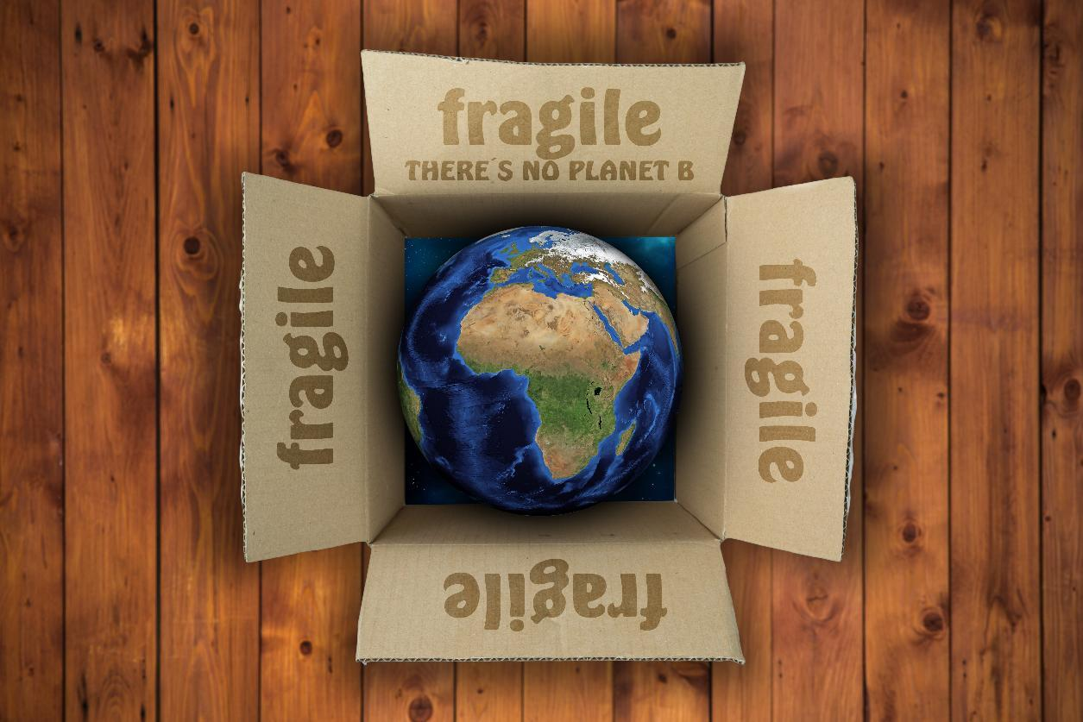
We will care for this precious gift!
Notes:
Slide 10: ‘We will care for this precious gift.’
So, join with me if you would like to…..

Slide 11
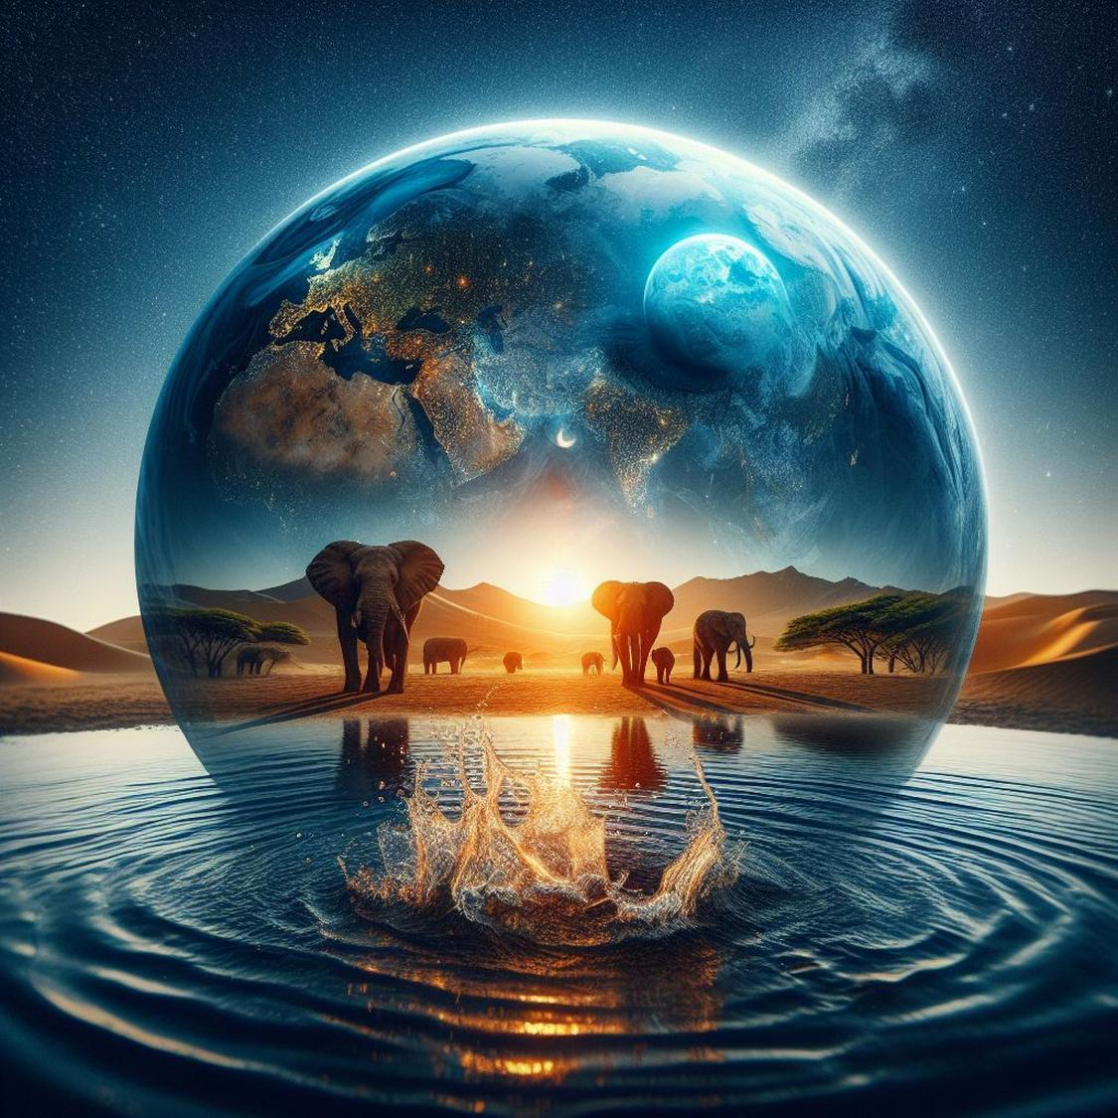
Notes:
Slide 11: Planet Earth is a place of wonder…..

Slide 12

We will care for this precious gift!
Notes:
Slide 12: ‘We will care for this precious gift.’

Slide 13
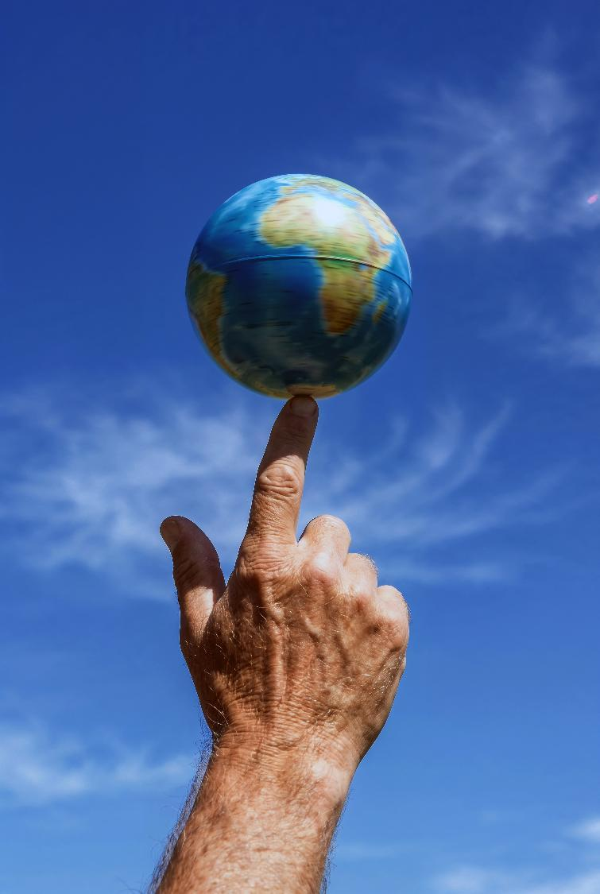
Notes:
Slide 13: Planet Earth is a fragile and perfect balance of earth, sea and sky, and we need to keep it that way….

Slide 14
We will care for this precious gift!
Notes:
Slide 14: ‘We will care for this precious gift.’

Slide 15
Notes:
Slide 15: Planet Earth is our shared home…..

Slide 16
We will care for this precious gift!
Notes:
Slide 16: ‘We will care for this precious gift.’

Slide 17
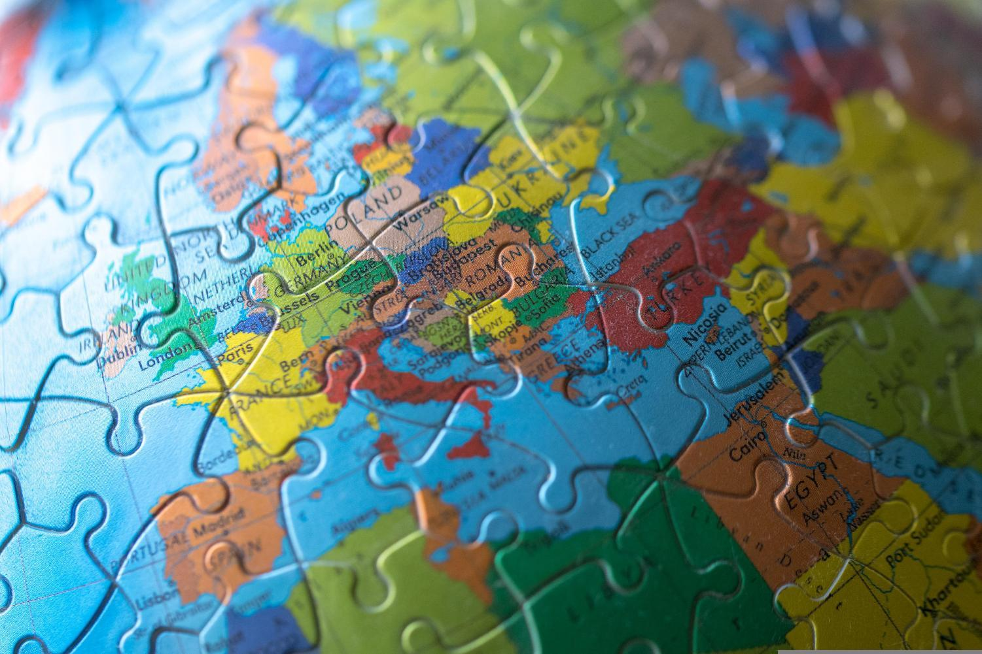
Notes:
Slide 17: Even when it’s difficult…..

Slide 18
We will care for this precious gift!
Notes:
Slide 18: ‘We will care for this precious gift.’

Slide 19


Slide 20
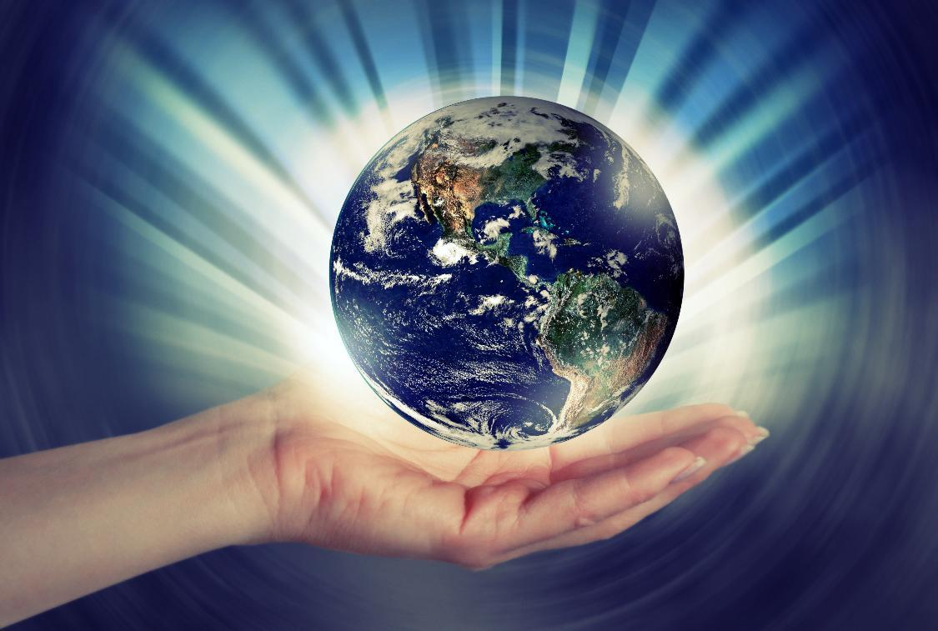


Leader: As we leave this place & time and go into the day ahead…
All: May we care for this precious gift!
Notes:
Sending: Slide 20
Leader: As we leave this place and time and go into the day ahead…
All: May we care for this precious gift!

Slide 21

Notes:
Slide 21: Reflective areas
You will need a large map or globe and some plasters (NB check you can peel them off easily!]
Think: Think about the things that you love about our beautiful Planet Earth.
Talk: Talk about how we can be more careful and responsible in the way that we live. What promises should we make?
Do: Write your idea on a plaster and stick it onto the world map to show your promise. You might also want to pray for God’s help.

Slide 22
The fragile gift
Notes:
The Fragile Gift…a reflective, interactive story….
Use these slides if you want to tell the story yourself, with still images of any of the video elements.

Slide 23
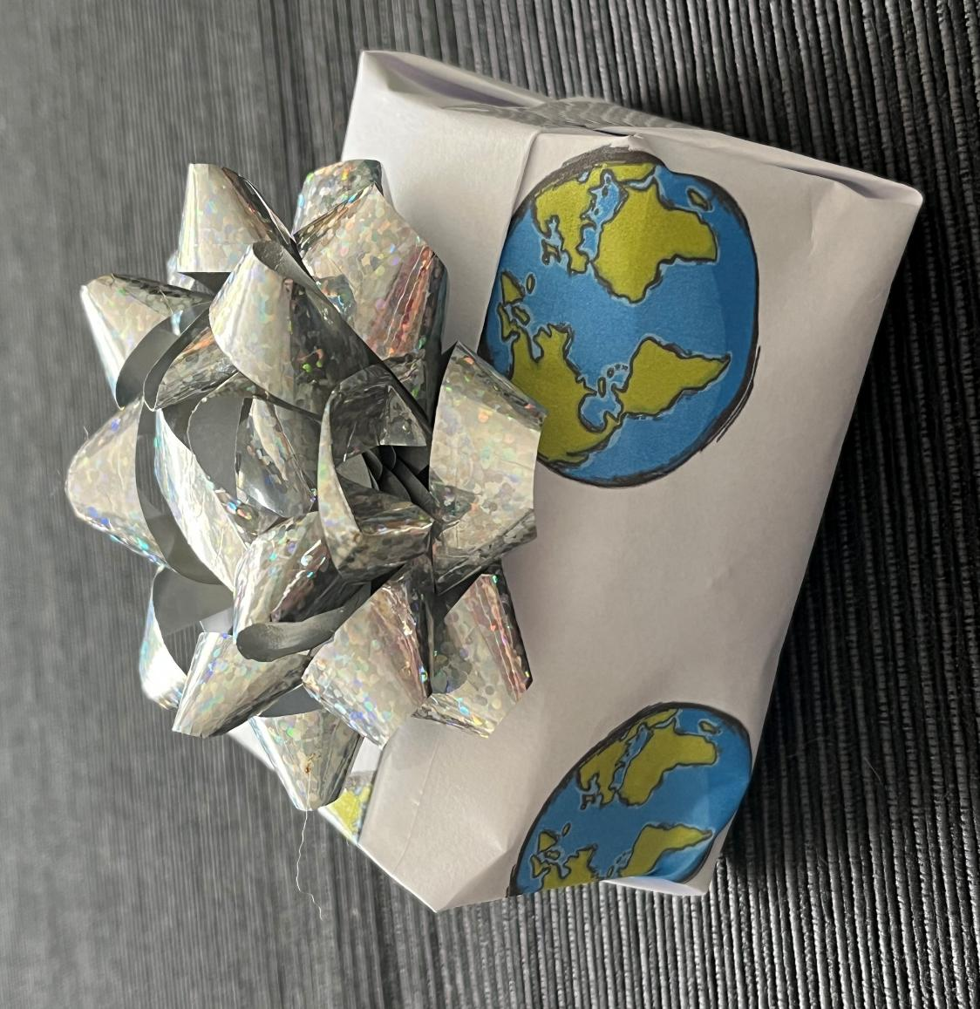
Notes:
Our Blue Planet is a precious gift….

Slide 24
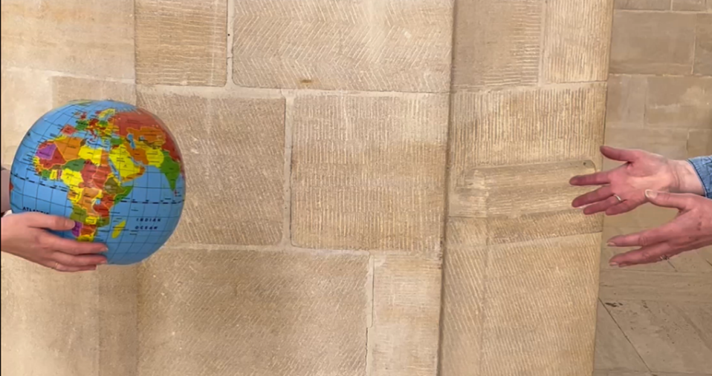
Notes:
…..full of beautiful things for us to enjoy, a place for us to live and love and play in….
There are many different beliefs about how it all started…

Slide 25
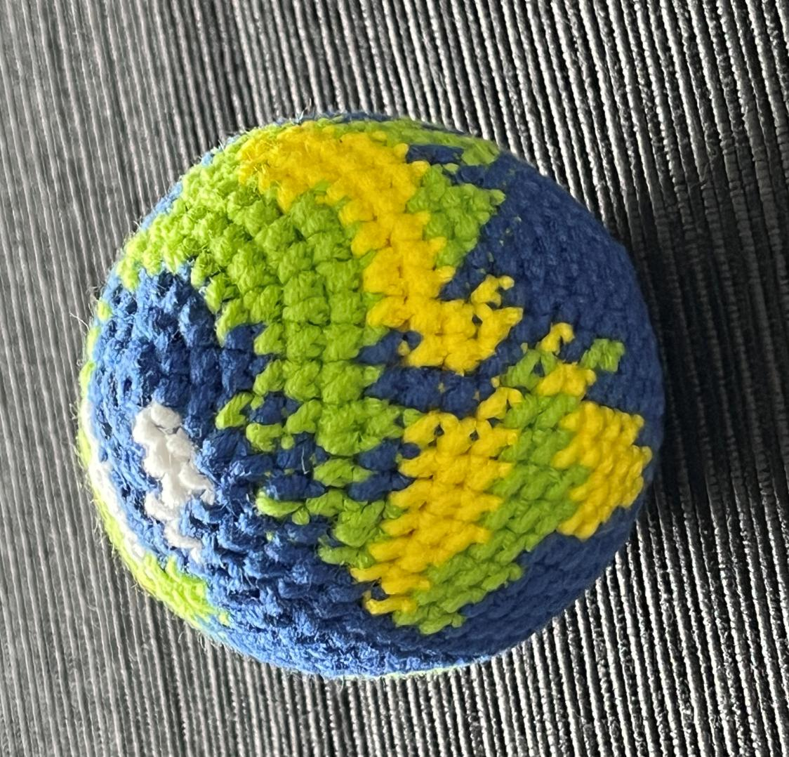
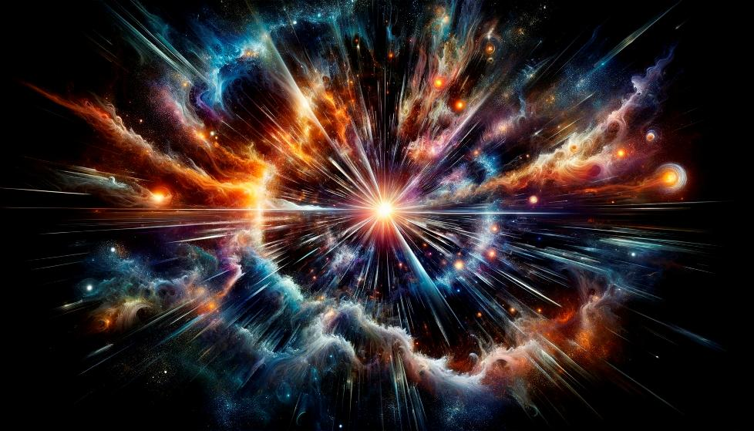
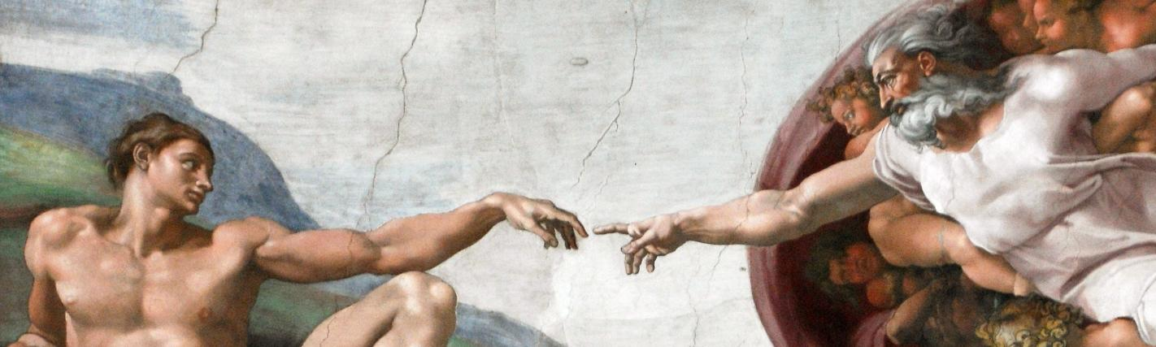
Notes:
…some say with a Bang, others that ‘God made….’, but there is no doubt that our planet is a precious place……. a perfect balance of earth and ice and sea and sky….

Slide 26
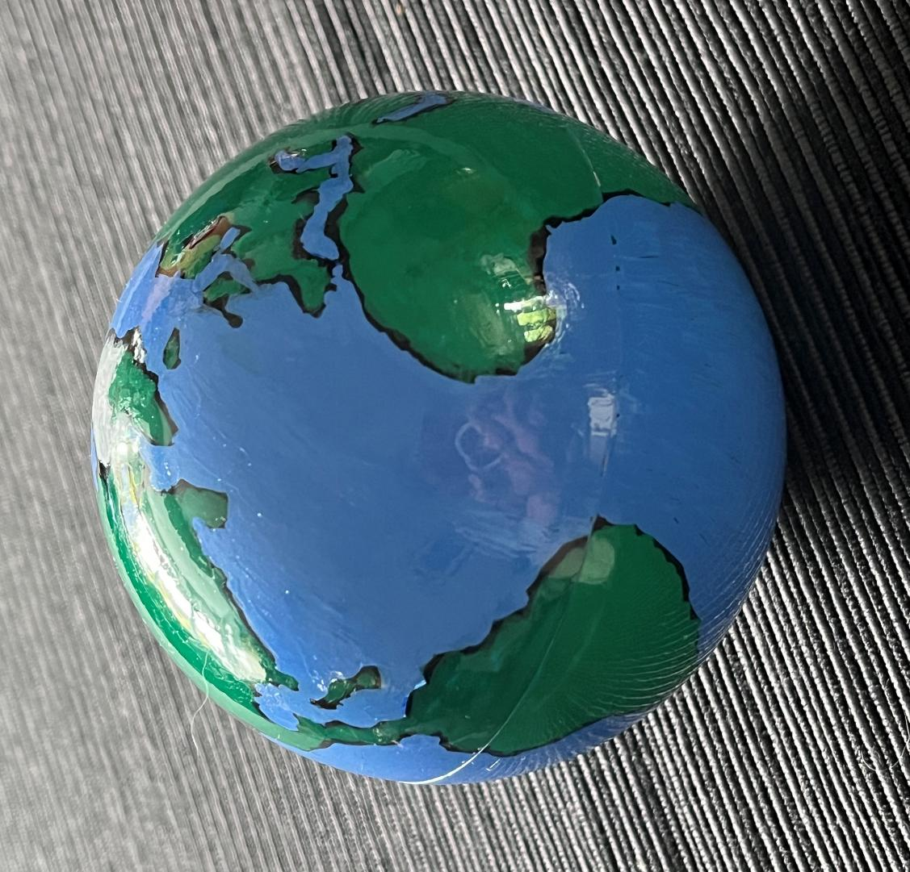

Notes:
Planet Earth is our fragile, beautiful, shared home, a place where we belong, together. We share this space with millions of different creatures and plants….I wonder which are your favourite?.... [PAUSE to find out]

Slide 27
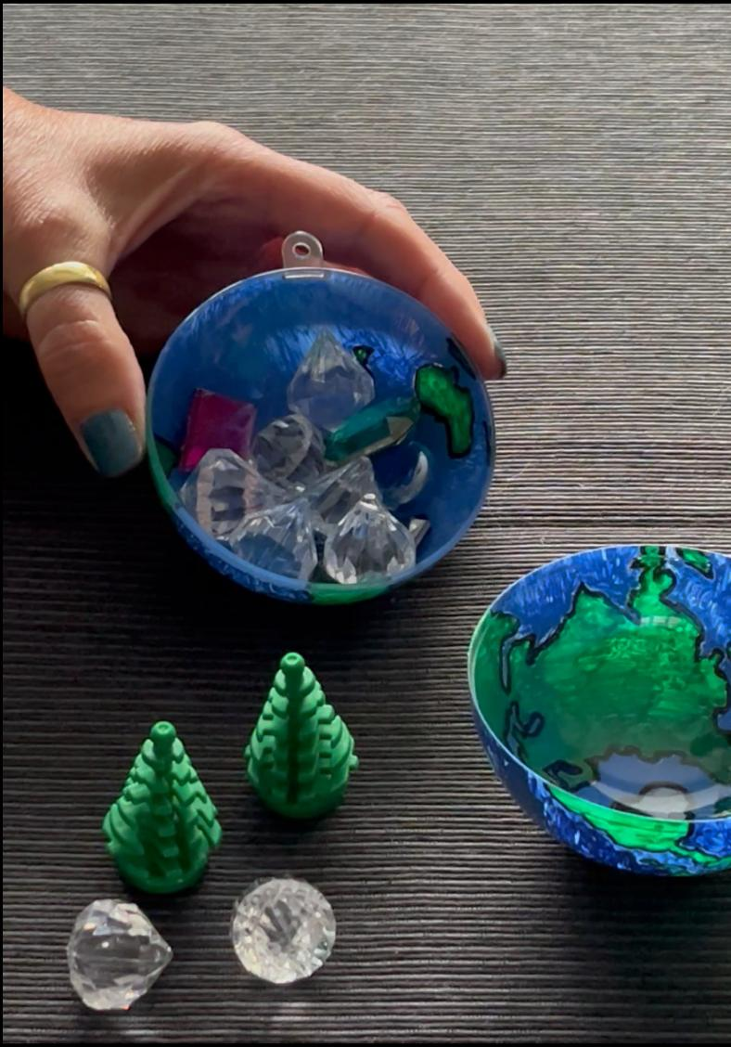
Notes:
But our beautiful planet also holds many treasures, some buried deep beneath its surface….others growing from the earth, treasures that we all depend on..…things that have made some people rich beyond compare….….and that others have wasted.
Imagine if we had to choose between these treasures and the survival of all the wonderful creatures we have just named?....What would you decide?.... [PAUSE to find out]

Slide 28
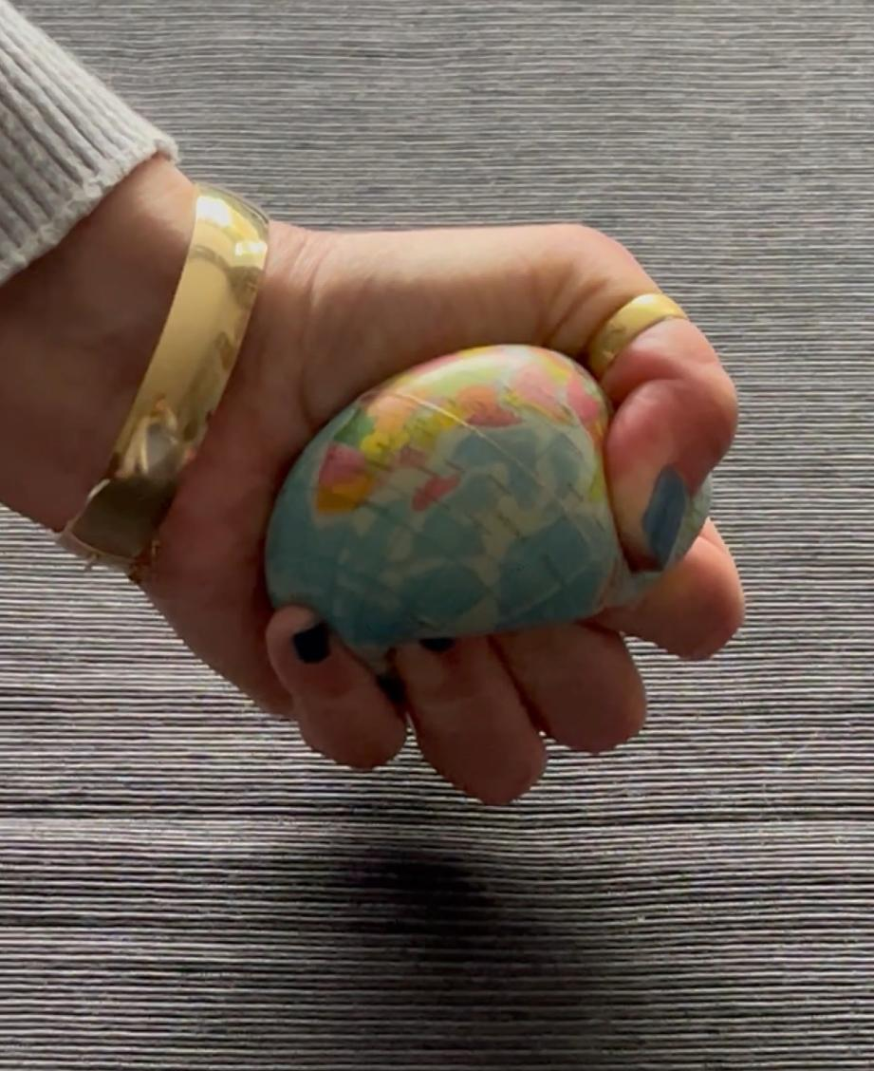
Notes:
It’s true that we haven’t always cared for our precious Planet Earth as we should – and now our planet is showing us the damage that we have caused….

Slide 29

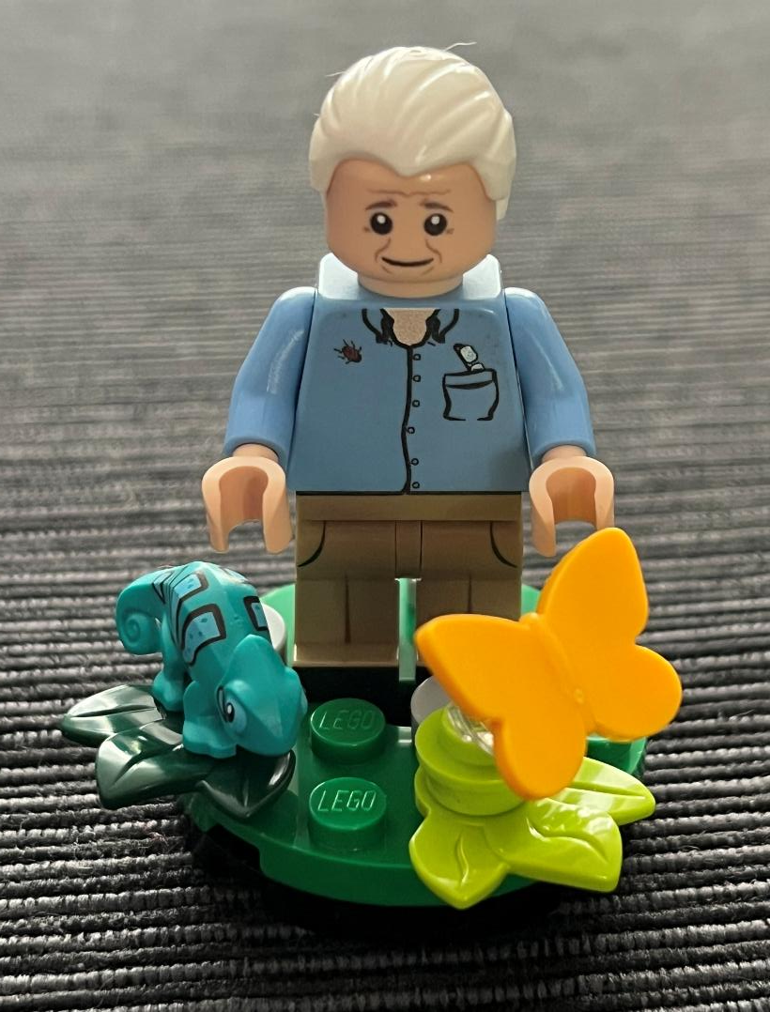
Cherish the natural world, because we’re a part of it and we depend on it!
Notes:
But all is not yet lost…. People like this great man, who turned 100 this year, have shown us the many extraordinary wonders of our natural world – and reminded us that we should “Cherish the natural world, because [we]’re a part of it and [we] depend on it.” And every human being has a part to play in its present and its future…..we can all still make a difference….there is still time!

Slide 30
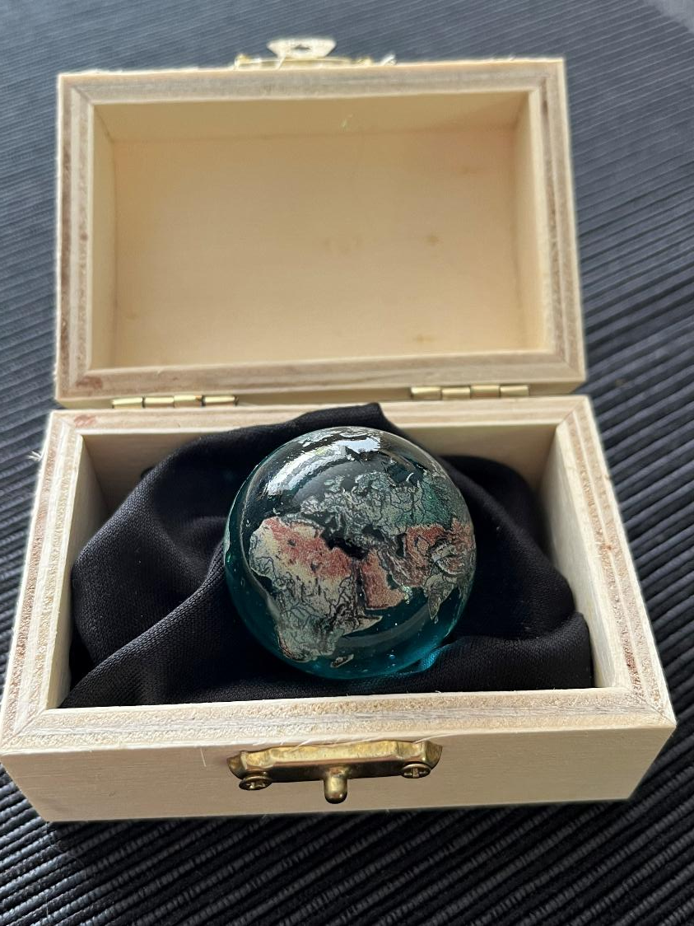
Notes:
So, let’s treat Planet Earth, our shared home, like the treasure that it is, a fragile and precious gift that we must love and look after.....for ourselves and for every living thing.

Slide 31
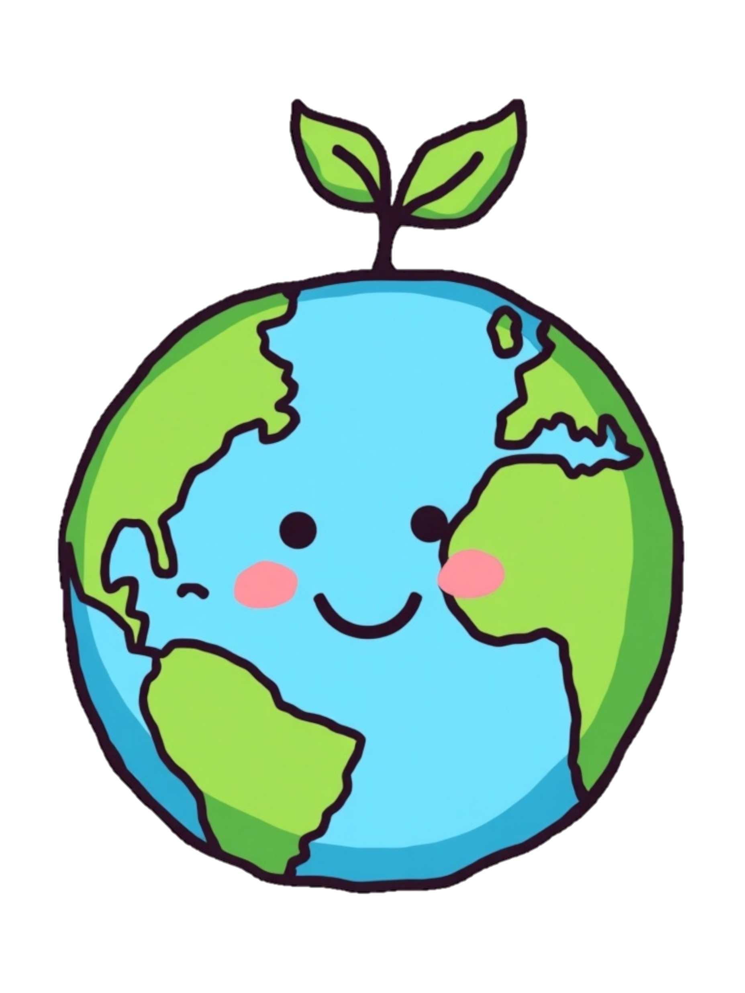
© A Diocese of Guildford resource

